Slide 1
Opportunity Zone General Questions

Slide 2
What is a Qualified Opportunity Zone (QOZ)?
A Qualified Opportunity Zone (QOZ) is an economically distressed community where new investments, under certain conditions, may be eligible for preferential tax treatment. Localities qualify as QOZs if they have been nominated for that designation by a state, the District of Columbia, or a U.S. territory and that nomination has been certified by the Secretary of the U.S. Treasury via his delegation of authority to the Internal Revenue Service (IRS).

Slide 3
How were QOZs created?
QOZs were added to the tax code by the Tax Cuts and Jobs Act on December 22, 2017.
The 2017’s Tax Cuts and Jobs Act established the Qualified Opportunity Zone program to offer tax benefits to private investors who invest in these communities. Since the passing of the law, Opportunity Zones were identified in all 50 states as well as the District of Columbia and five territories and commonwealths including American Samoa, Guam, Northern Mariana Islands, Puerto Rico and the U.S. Virgin Islands.
More than 8,700 Qualified Opportunity Zones have been designated across the U.S. According to the Urban Institute, the majority of these zones have lower household incomes, higher poverty rates and higher unemployment rates than those of other communities.

Slide 4
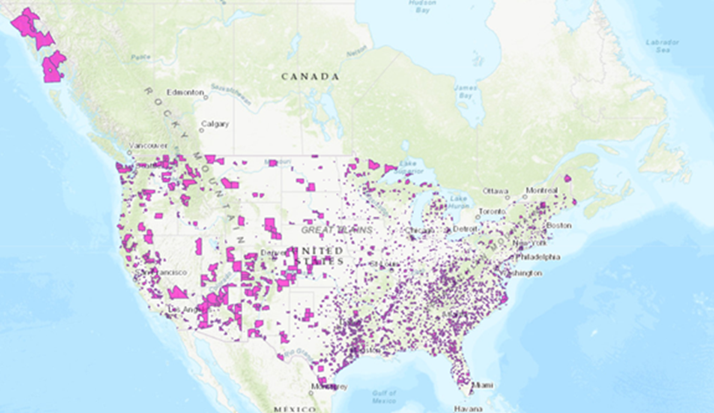
Have QOZs been around a long time?
The first set of QOZ designations, covering parts of 18 states, were designated on April 9, 2018.

Slide 5
What is the purpose of QOZs?
QOZs are an economic development tool—that is, they are designed to spur economic development and job creation in distressed communities.

Slide 6
How do QOZ’s Work?
To encourage private participation, individuals who invest in Qualified Opportunities Zones are eligible for tax incentives.
Also noteworthy, investors can use the proceeds from any appreciated asset. It’s not a requirement to invest with a like-kind asset to defer potential gains.

Slide 7
How do QOZs spur economic development?
Tax Incentives for Investors
Tax Deferral Through 2026. First, an investor can defer tax on any prior eligible gain to the extent that a corresponding amount is timely invested in a Qualified Opportunity Fund (QOF). The deferral lasts until the earlier of the date on which the investment in the QOF is sold or exchanged, or December 31, 2026.
Step-up Tax Deferral. If the QOF investment is held for at least 5 years, there is a 10% exclusion of the deferred gain. If held for at least 7 years, the 10% exclusion becomes 15%. Additionally, the amount of eligible gain to include is decreased to the extent that the amount of eligible gain you deferred exceeds the fair market value of the investment in the QOF.
1
2

Slide 8
Tax Deferral Through 2026 (Example)
For example, if a taxpayer sells an asset for $5 million, which then results in a $5 million capital gain, the investors can invest the proceeds into a Qualified Opportunity Zone Fund. As long as this happens within 180 days of the sale, the investor can avoid capital gains taxation. This allows the investor to keep the $1 million instead of facing possible taxation on the gain (assuming the 2019 IRS rate of 20%). This could potentially provide a substantial return for the investor through the life of the investment.

Slide 9
Step-up Tax Deferral (Example)
Investors who decide to invest in Qualified Opportunity Zone Funds can receive a 10% step-up basis after five years of investing in the fund before 2026. Additionally, investors can receive an extra 5% step-up basis after seven years before 2026. To maximize the step-up basis, investors must invest by December 31, 2019. Also, they must keep assets in the fund for at least seven years to receive the total 15% step-up basis.
If we use the example above, after five years of investing in the fund, the taxpayer may be given a $500,000 basis.
This is 10% of the original $5 million capital gain deferred. If the investment is held in the fund for seven years, the investor may be given another $250,000 of basis in the fund. This is 5% of the original capital gain. Together, this is a total of $750,000, or 15% of the original capital gain.

Slide 10
How do QOZs spur economic development?
Tax Incentives for Investors
Appreciation in value not Taxed. Second, if the investor holds the investment in the QOF for at least 10 years, the investor is eligible for an adjustment in the basis of the QOF investment to its fair market value on the date that the QOF investment is sold or exchanged. As a result of this basis adjustment, the appreciation in the QOF investment is never taxed. A similar rule applies to exclude the QOF investor’s share of gain and loss from sales of QOF assets.
3

Slide 11
Appreciation in Value is
Not Taxed (Example)
For example, let’s say a taxpayer makes a $5 million investment in a Qualified Opportunity Zone Fund in 2019. If the investor sells the investment in 2029 for $10 million, the $5 million in appreciation is free of taxation. However, the investor will have to pay income taxes since the fund was held beyond 2026. These taxes will correspond with the sale of the investment.

Slide 12
Do I need to live in a QOZ to take advantage of these tax incentives?
No. You can take advantage of these tax incentives even if you don’t live, work, or have an existing business in a QOZ. All you need to do is invest the amount of a recognized eligible gain in a QOF and elect to defer the tax on that gain

Slide 13
I am interested in knowing where the QOZs are located.
Is there a list of QOZs available?
Yes. The list of each QOZ can be found in IRS Notices 2018-48 PDF and 2019-42 PDF. Further, a visual map of the census tracts designated as QOZs may be found at Opportunity Zones Resources
(https://www.cdfifund.gov/Pages/Opportunity-Zones.aspx)

Slide 14
Summary
Opportunity Zones are an economic development tool for impoverished communities.
Opportunity Zones were created by the Tax Cuts and Jobs Act on December 22, 2017.
Approximately 8,700 Opportunity Zones in USA and territories.
Opportunity Zones use Federal Income Tax Deferments to encourage investment in targeted areas.
Opportunity Zone Program is active until 2026.

Slide 15
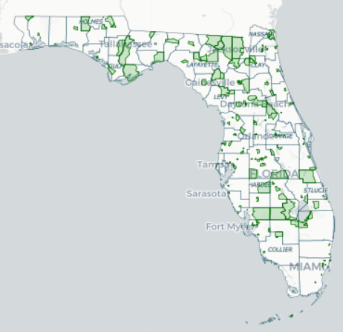
427 Opportunity Zones in Florida
Opportunity Zones area a low-income census tract specially nominated by the Governor of a State. These zones are designed to spur economic development and job creation in low-income communities.

Slide 16
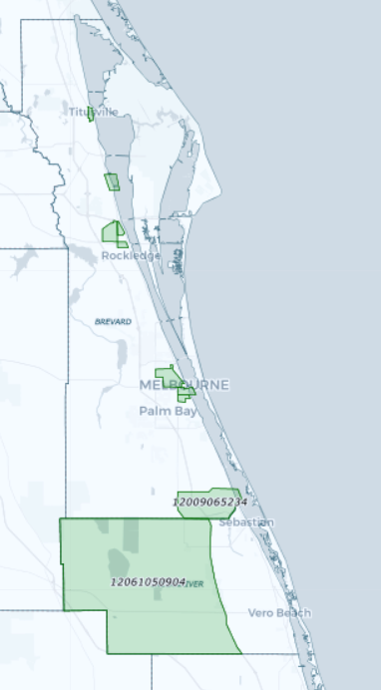
10 Opportunity Zones in Brevard County

Slide 17
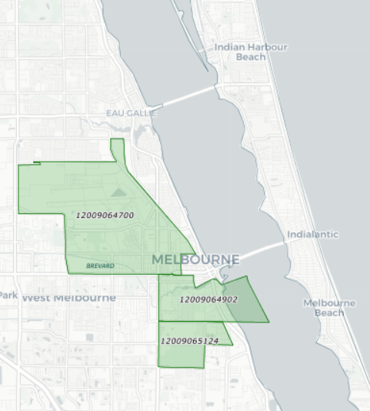
3 Opportunity Zones in Brevard County
Census Tract 647
Census Tract 651.24
Census Tract 649.02

Slide 18
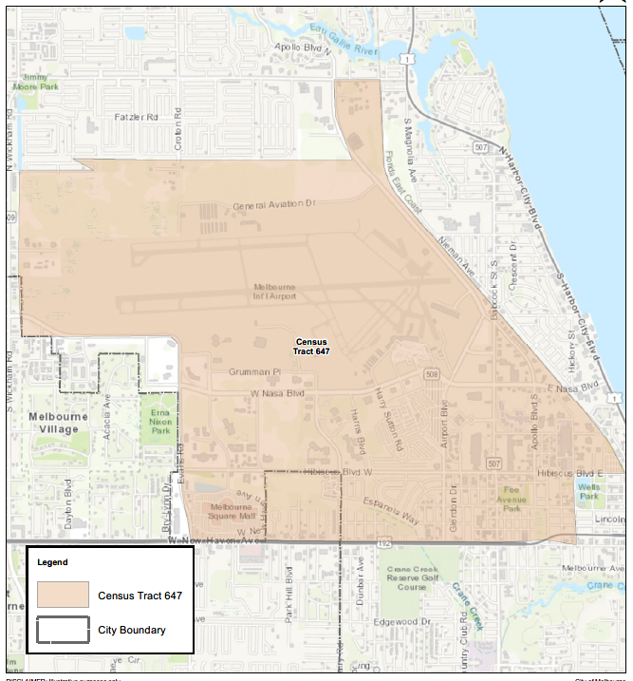
3 Opportunity Zones in Brevard County
Census Tract 647
Melbourne International Airport and Commerce Park
Portions of Downtown and Babcock CRA

Slide 19
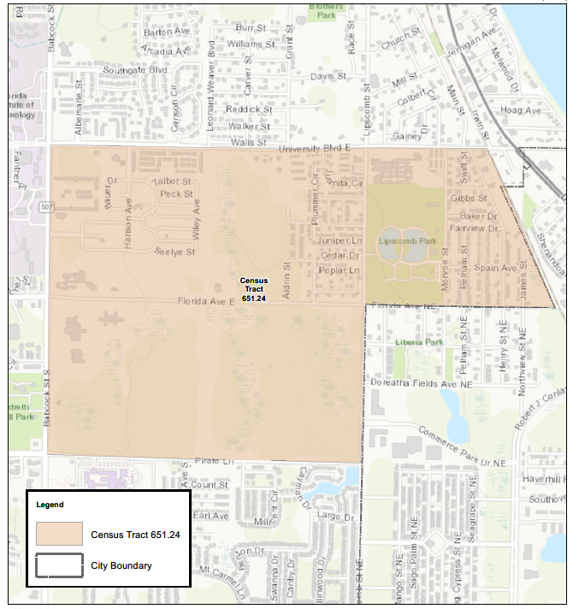
3 Opportunity Zones in Brevard County
Census Tract 651.24
Stonewood Townhomes
Melbourne Central Catholic High School
Stone Magnet Middle School
Lipscomb Park
Lakewood Village
Adjacent to FIT

Slide 20
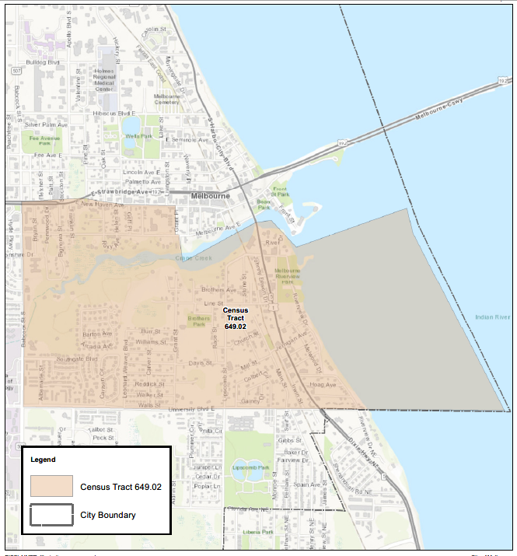
3 Opportunity Zones in Brevard County
Census Tract 649.02
Portions of Downtown
Crane Creek
Riverview Park

Slide 21
Summary
427 Opportunity Zones in the State of Florida.
10 Opportunity Zones in Brevard County.
3 Opportunity Zones in City of Melbourne.

Slide 22
LOCAL BUSINESSES UTILIZING OPPORTUNITY ZONES

Slide 23

Aerion Melbourne
Supersonic business jet manufacturing
Over $300 M of new investment
650 high wage new jobs between 2020-2026
Collaboration between: State, Space Florida, MLB, EDC & City to induce site selection within Melbourne
Advised Client of OZ availability

Slide 24
What Local Governments Can and Can’t do for Opportunity Zones
The OZ program is a tax benefit claimed by investors, not local governments.
Private investors (not local governments) will be required to comply with reporting requirements set forth by the Internal Revenue Service, which is responsible for developing and enforcing regulations for OZ tax benefits.
Unless requirements are imposed on local governments by their state government, local governments have no administrative, reporting, or regulatory responsibility for the OZ program.

Slide 25
What Local Governments Can and Can’t do for Opportunity Zones
Advocate and Increase Awareness of the OZ Program to Investors and Land owners.
Coordinating with Property Owners and QOF Managers.
Leverage local resources, CRA/TIF, local incentives and assistance programs.
Now local governments may identify investment-ready (or “shovel ready”) projects in designated OZs and put those projects in front of OZ investors (QOF Managers).
EXAMPLES: Orange County Government’s, Opportunity Zone Prospectus 2019
Space Coast Economic Development Commission’s Opportunity Zone Project Information and Intake (Information Clearinghouse)
https://spacecoastedc.org/opportunity-zones-faq/
City of Tallahassee/Leon County’s, Opportunity Zone Prospectus 2019

Slide 26

Local Contact
Monclaude Nestor
Vice President, Relationship Manager
Community Development Banking
7121 Fairway Drive, Suite 300
Palm Beach Gardens, FL 33418
(p) 216.222.2770 | (c) 305.748.0569 | (f) 833.509.0753
monclaude.nestor@pnc.com

